Slide 1
STRESS MANAGEMENT
DR A UMUKORO
MBBS,IB

Slide 2
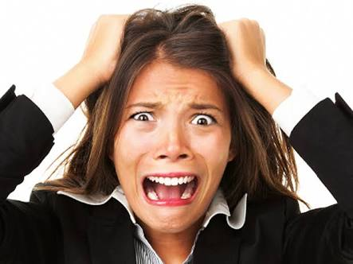

Slide 3
What is stress?
Stress is a subjective feeling of being overwhelmed by the demands of life.
Stress can be useful if it is short-term
It causes problems mainly when it is long standing

Slide 4
Medical manifestations of stress
Difficulty sleeping
Weight gain/loss
Ulcer symptoms
Irritability
Frequent,severe headaches
Difficulty concentrating
Excessive sleeping

Slide 5
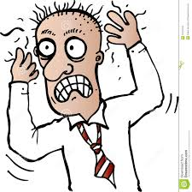

Slide 6
Medical manifestations of stress
Social isolation
Fatigue
Nausea
Feeling of being overwhelmed
Obsessive or compulsive behaviours

Slide 7
Tips on managing stress
Keep a positive attitude
Accept there are events that you cannot control
Be assertive, not aggressive with life

Slide 8
Tips(contd)
Exercise regularly – at least 30 minutes of aerobic exercise for at least 3 days of the week
Eat/drink healthy- avoid smoking; if you must drink alcohol, make it moderate.
Learn time management skills- plan well and start early

Slide 9


Slide 10
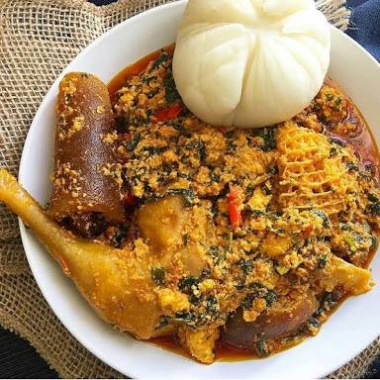

Slide 11
Tips(contd)
Learn to say NO to requests that would create excessive stress
Create time for hobbies, positive interests and relaxation
Get enough rest and sleep- at least 6 hours every night for an adult. A 15-30-minute post lunch nap is also very beneficial.

Slide 12
Tips(contd)
Don’t rely on alcohol or drugs to get by. They may help short-term but destroy in the long term
Seek out social support. Have people you can share things that bother you with.
Do your medicals at least twice a year if over 40.

Slide 13
Tips(contd)
If you feel overwhelmed for long or feel suicidal or tired of living, you will need to see your doctor. You might have a depressive disorder and there are treatments that can help.

Slide 14
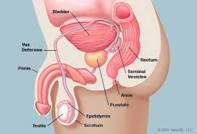
PROSTATE CANCER

Slide 15
What is the prostate?
The prostate is a walnut-sized organ that lies just under the urinary bladder in men only
It contributes to the fluid found in semen

Slide 16
What predisposes to prostate cancer?
Age
Family history (esp in a first degree relative)

Slide 17
How prostate cancer manifests?
Frequent urination, especially at night
Difficulty urinating freely
Being unable to hold urine back
Feeling like you cannot get all the urine out
Back pain
Bone pain

Slide 18
How to prevent prostate cancer
A diet high in fruits and vegetables and low in saturated fat is said to be protective

Slide 19
What to do when you have any of these symptoms
See a doctor and explain
You will need to do some blood tests,esp PSA and a prostate scan
Your doctor will advise you based on results of the tests you have done

Slide 20
DIABETES
Diabetes is a medical condition where the body cannot make use of glucose derived from food.
“suffering in the midst of plenty”

Slide 21
Things that predispose to diabetes
Age
Family history
Obesity
Bad diet
Smoking
Alcohol use

Slide 22
Manifestations of diabetes
Excessive urination
Excessive thirst/intake of water
Weight loss
Problems to the eyes,heart,brain,kidneys,limbs

Slide 23
How to prevent diabetes
Eat healthy
Avoid smoking/alcohol
Exercise regularly
Do your medicals at least twice a year
See your doctor if you have any of these symptoms

Slide 24
When your doctor says you have diabetes
Understand that it is not a death sentence
While diabetes cannot be cured, it can be managed successfully
Take what you eat/drink seriously
Exercise regularly
Take your medications as prescribed by your doctor
Take your appointments with the doctor seriously

Slide 25
Des questions?

Slide 26
Merci
www.webmd.com

